Slide 1
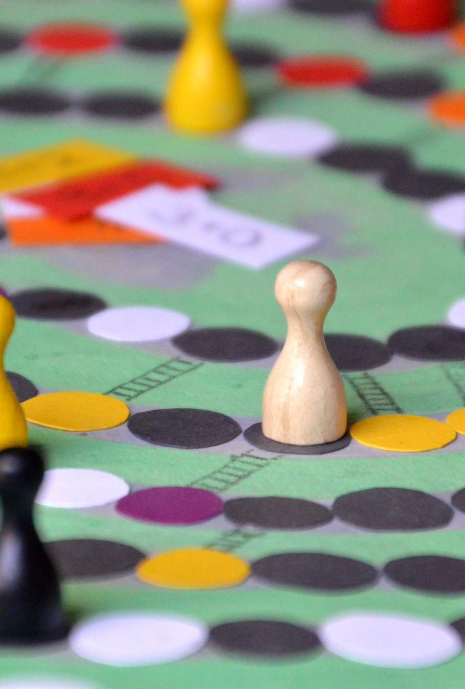
SECTION 1 The Single-Person Decision Problem
Game theory: Modeling strategic interactions between rational agents
Our Approach: Principles (Depth), not applications (Breadth)
- Decision Theory
Class 3

Slide 2
Course Structure
REVIEW
SECTIONS
Topics
The Rational Choice Paradigm
The Expected Utility Theory
Decisions over Time
Section 1
The Single-Person Decision Problem
Section 2
Static Games of Complete Information
Section 3
Dynamic Games of Complete Information
Section 4
Games of Incomplete Information
TOPICS
MODULES
Ch 1, 2
Language
Preparatory ideas
Ch 3-6
Ch 7-11
Ch 12, 15

Slide 3


TOPIC 1 The Rational Choice Paradigm
Statisticians
Philosophers
A subset of normative decision theory that studies how…
…rational agents choose actions to maximize utility,
…given their preferences and available information
Computer Scientists
Economists
Psychologists
…a starting point
Core Ideas & Vocabulary
…of game theory
Decision Theory: How individuals make choices under conditions of uncertainty and risk
Descriptive: Seeks to explain and predict how real people actually make decisions
(empirical, experimental psychology)
- Limited
- Fundamental
Normative: Seeks to prescribe what a rational decision-maker ought to do (math models)

Slide 4

MODULE 1 Actions, Outcomes, and Preferences
Rational Choice Paradigm
Building blocks of decision-making
Game Theory
Precise

Slide 5
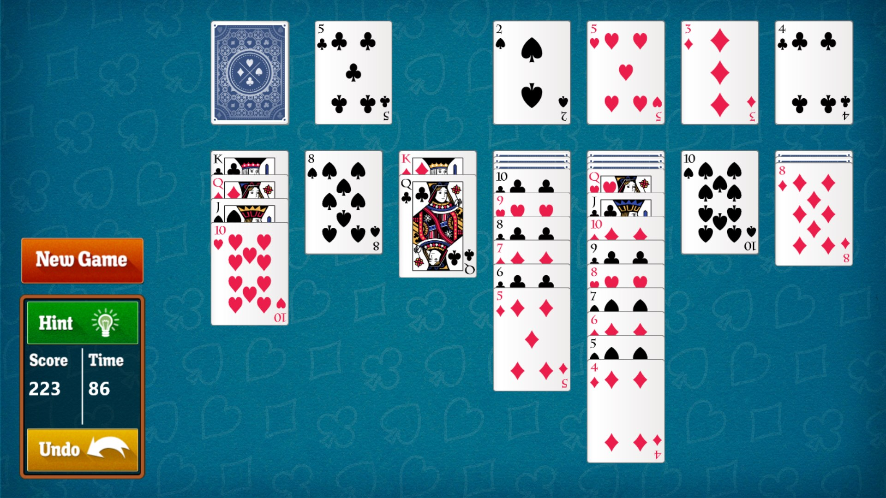




The Single-Person Decision Problem
Opponents
Allies
The decision-maker
…not a strategic interaction
Personal tradeoffs, not a response
Conditional logic: ‘If-then’
…shares vocabulary with game theory

Slide 6
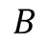
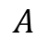
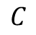
The Single-Person Decision Problem
Not a strategic interaction
Consequences are…
…not influenced by actions of others
…borne by the decision-maker
…well-being
Actions
Outcomes
Preferences
$$B$$
$$A$$
$$C$$
Choices
Consequences
Priorities
…choosing the best action
Choices are over actions
Preferences are over outcomes

Slide 7

A Simple Decision Problem ‘How to spend a Friday evening?’
The decision-maker
How should she decide?

Slide 8








Actions ($A$)
More actions
Watch a movie.
Go to bed early.
Do nothing.
Read a novel.
Go for a run.
Watch ‘How to be productive’ videos on YouTube.
Scroll social media.
…
…
…all available alternatives to choose from
…this is an ‘action’ too
Comprehensive
Practical
Study for Exam
Play Games
Socialize with Friends
Modeling is an art…
Every possible action must be specified; otherwise, the decision will be made based on incomplete information.
$$A=\left\{S, G, F\right\}$$
Set of Actions

Slide 9

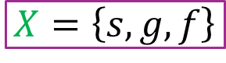
Outcomes ($X$)
…consequences of actions
Study for Exam
Play Games
Socialize with Friends
Play Games
Play Games
Better Prepared for Exam
Immediate Relaxation
Build Relationships
$$A=\left\{S, G, F\right\}$$
$$X=\left\{s, g, f\right\}$$
Set of Actions
Set of Outcomes

Slide 10

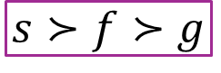
Preferences over Outcomes ($≿$)
Pair-wise comparisons
…ranking all outcomes
Study for Exam
Play Games
Socialize with Friends
Better Prepared for Exam
Immediate Relaxation
Build Relationships
$$A=\left\{S, G, F\right\}$$
$$X=\left\{s, g, f\right\}$$
$$s≻f≻g$$
Set of Actions
Set of Outcomes
Preference Relations

Slide 11
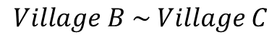
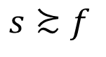
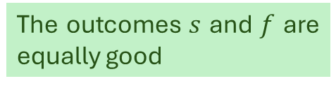
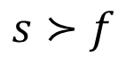
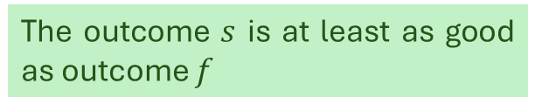

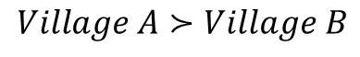
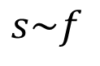
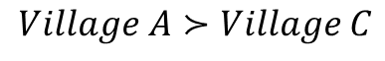
Preference Relations
…comparing a pair of outcomes
$$s≻f$$
$$s≿f$$
$$s\sim f$$
A strict preference relation
A weak preference relation
Indifference relation
The outcome $s$ is strictly better than outcome $f$
The outcome $s$ is at least as good as outcome $f$
The outcomes $s$ and $f$ are equally good
$$Village A≻Village B$$
$$Village A≻Village C$$
$$Village B \sim Village C$$

Slide 12


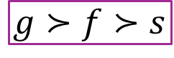

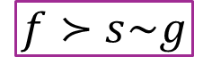
Preferences over Outcomes ($≿$)
Personalities & Priorities
$$s≻f≻g$$
$$f≻s\sim g$$
$$g≻f≻s$$

Slide 13


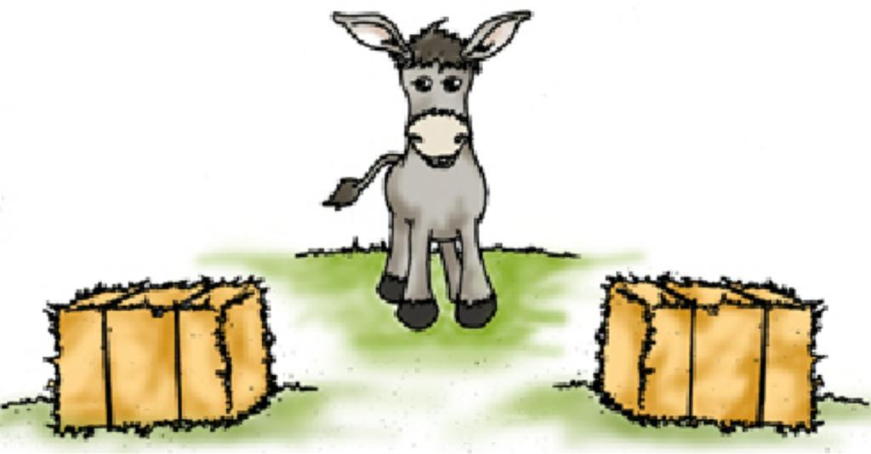


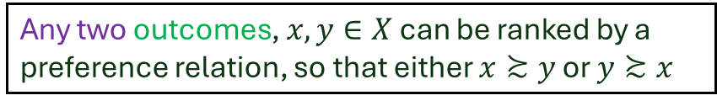
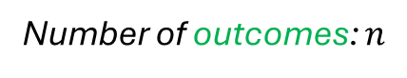
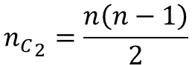
Axiom 1 Preference Relations are Complete
Number of outcomes: $n$
I don’t know which one I like more…
Am I overthinking this? Maybe I should flip a coin... wait, I don’t have hands!
Number of outcome-pairs:
$${n_{C}}_{2}=\frac{n\left(n−1\right)}{2}$$
Buridan’s donkey
The Ultimate Overthinker
Any two outcomes, $x, y∈X$ can be ranked by a preference relation, so that either $x≿y$ or $y≿x$
Lesson: Don’t be a donkey.
Assumption 1: The decision-maker is…decisive and can compare and rank any two outcomes
Axioms about Preference Relations

Slide 14



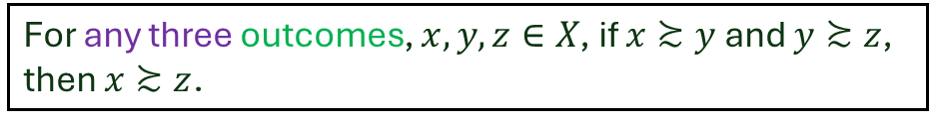

Axiom 2 Preference Relations are Transitive
The decision-maker
$$≻$$
$$≻$$
$$≻$$
For any three outcomes, $x, y, z∈X$, if $x≿y$ and $y≿z$, then $x≿z$.
LOOPY PREFERENCES
Assumption 2: The decision-maker can rank all outcomes consistently without contradictions
Axioms about Preference Relations

Slide 15
Rational Preference Relations
A preference relation that is complete and transitive…
Complete: Any two outcomes can be ranked.
Transitive: The ranking is consistent.
The decision-maker will always have at least one best outcome that is as good as or better than any other outcome in that set
…finding the action corresponding to…
Solving the single-person decision problem

Slide 16

The Single-Person Decision Problem
A single-person decision problem consists of three components:
Actions are all the alternatives from which the player can choose.
Outcomes are the possible consequences that can result from any of the actions.
Preferences describe how the player ranks the set of possible outcomes, from most desired to least desired.

Slide 17




A Decision Problem: Ordering Food
$$\#$$
Quantity
Price
BURGER & COKE
₹420
BURGER
₹220
MEAL
₹440

Slide 18

MODULE 2 The Payoff Function
Rational Choice Paradigm
…a convenient way to model preferences
Game Theory

Slide 19


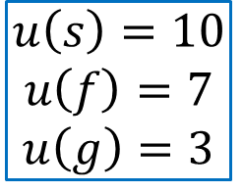
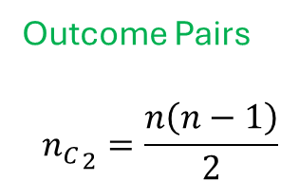

The Payoff Function: Ranking Outcomes
Preference relations = Pair-wise comparisons = Cumbersome
Rational preference relations
An alternative way to model preferences
The payoff function associates a number with each outcome in such a way that outcomes with higher numbers are preferred.
Outcome Pairs
$${n_{C}}_{2}=\frac{n\left(n−1\right)}{2}$$
Outcome 1
Indifference
Outcome 2
Payoff
Payoff 1
Outcome 3
Payoff function
Outcome 1
Payoff 2
$$s≻f≻g$$
$$u\left(s\right)=10$$
$$u\left(f\right)=7$$
$$u\left(g\right)=3$$
Modeling preferences
Convenient
Quantitative
Sorted list of outcomes: Most to least preferred
Preference relations
Payoff 3

Slide 20
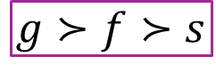
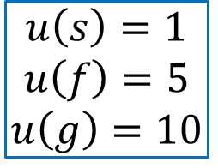
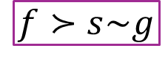
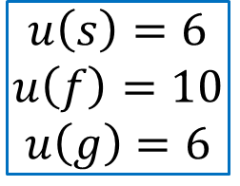
The Payoff Function: Ranking Outcomes
Preference relations are cumbersome…
Rational preference relations
An alternative approach to preference relations
The payoff function associates a number with each outcome in such a way that outcomes with higher numbers are preferred.
Payoffs can be compared within a person, not between people
Payoff function
Payoff function
Payoff function
$$s≻f≻g$$
$$u\left(s\right)=10$$
$$u\left(f\right)=7$$
$$u\left(g\right)=3$$
$$f≻s\sim g$$
$$u\left(s\right)=6$$
$$u\left(f\right)=10$$
$$u\left(g\right)=6$$
$$g≻f≻s$$
$$u\left(s\right)=1$$
$$u\left(f\right)=5$$
$$u\left(g\right)=10$$
Preference relations
Distinct
Distinct
Same actions
Same outcomes
Different preferences

Slide 21
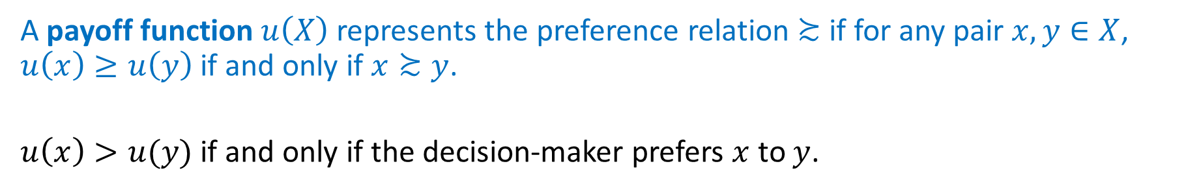
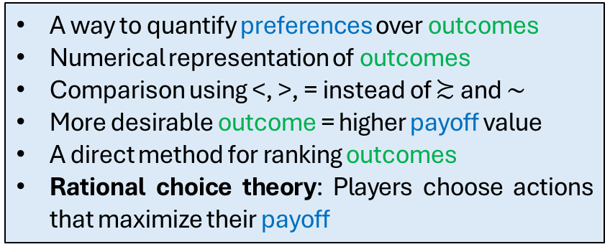
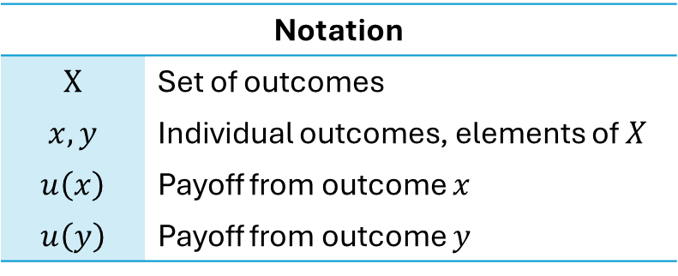
The Payoff Function: Ranking Outcomes
A payoff function $u\left(X\right)$ represents the preference relation $≿$ if for any pair $x, y∈X$, $u\left(x\right)≥u\left(y\right)$ if and only if $x≿y$.
$u\left(x\right)>u(y)$ if and only if the decision-maker prefers $x$ to $y$.
Notation
$$X$$ | Set of outcomes
$$x, y$$ | Individual outcomes, elements of $X$
$$u\left(x\right)$$ | Payoff from outcome $x$
$$u\left(y\right)$$ | Payoff from outcome $y$
A way to quantify preferences over outcomes
Numerical representation of outcomes
Comparison using <, >, = instead of $≿$ and $\sim$
More desirable outcome = higher payoff value
A direct method for ranking outcomes
Rational choice theory: Players choose actions that maximize their payoff

Slide 22
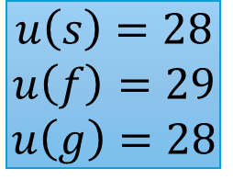
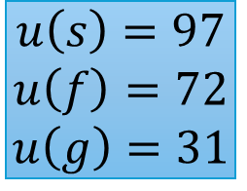
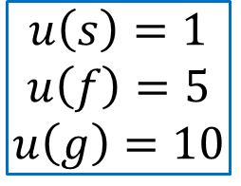

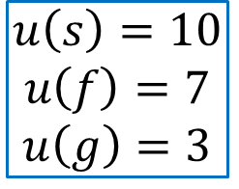
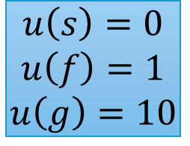
The Payoff Function: Ordinal Construct
Absolute values
Relative values
…only the order of preferences, not the intensity
Payoff function
Payoff function
Payoff function
$$u\left(s\right)=6$$
$$u\left(f\right)=10$$
$$u\left(g\right)=6$$
$$u\left(s\right)=1$$
$$u\left(f\right)=5$$
$$u\left(g\right)=10$$
$$u\left(s\right)=97$$
$$u\left(f\right)=72$$
$$u\left(g\right)=31$$
$$u\left(s\right)=28$$
$$u\left(f\right)=29$$
$$u\left(g\right)=28$$
$$u\left(s\right)=0$$
$$u\left(f\right)=1$$
$$u\left(g\right)=10$$
$$s≻f≻g$$
$$u\left(s\right)=10$$
$$u\left(f\right)=7$$
$$u\left(g\right)=3$$
$$f≻s\sim g$$
$$g≻f≻s$$
…must be consistent with preference relations

Slide 23



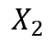
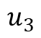
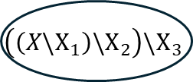
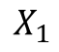
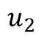
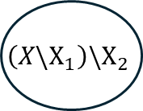
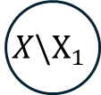
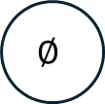
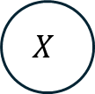
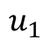
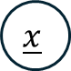
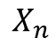

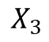
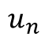
The Payoff Function: Existence
Assumptions
Finite
Complete
Transitive
Intuitive ideas
Math framework
Complete
Transitive
If the set of outcomes $X$ is finite, then any rational preference relation over $X$ can be represented by a payoff function.
…rational
Payoff function
$$\left(X\backslash X_{1}\right)\backslash X_{2}$$
$$\left(\left(X\backslash X_{1}\right)\backslash X_{2}\right)\backslash X_{3}$$
$$X\backslash X_{1}$$
$$X$$
Best outcome equivalence set
$$X_{n}$$
$$u_{n}$$
$$\underline{x}$$
…increasing
numerical
value
$$∅$$
Third worst outcome…
$$X_{3}$$
$$u_{3}$$
$X$ is finite
Second worst outcome…
$$X_{2}$$
$$u_{2}$$
Worst outcome equivalence set
$$X_{1}$$
$$u_{1}$$

Slide 24
The Payoff Function: Existence
Complete
Transitive
If the set of outcomes $X$ is finite, then any rational preference relation over $X$ can be represented by a payoff function.
Proof (by construction)—
The preference relation is complete and transitive. We can, therefore, find a least-preferred outcome $\underline{x}∈X$ such that all other outcomes $y∈X$ are at least as good as $\underline{x}$. That is, $y≿\underline{x}$ for all other $y∈X$.
We can then define the ‘worst outcome equivalence set,’ denoted by $X_{1}$, to include $\underline{x}$ and any other outcome for which the player is indifferent between it and $\underline{x}$.
From the remaining elements $X\backslash X_{1}$ (all elements in set $X$ that are not in set $X_{1}$), we can define the ‘second worst outcome equivalence set,’ $X_{2}$.

Slide 25
The Payoff Function: Existence
Complete
Transitive
If the set of outcomes $X$ is finite, then any rational preference relation over $X$ can be represented by a payoff function.
Proof (by construction)—
Continue in this fashion until the ‘best outcome equivalence set,’ $X_{n}$, is created. Because $X$ is finite and $≿$ is rational, such a finite collection of $n$ equivalent sets exists.
Now consider $n$ arbitrary values $u_{n}>u_{n−1}>…>u_{2}>u_{1}$ and assign payoffs according to the function defined by—
For any $x∈X_{k}$, $u\left(x\right)=u_{k}$.
This payoff function represents $≿$. Hence, we’ve proved that such a function exists.

